Slide 1
EduAI: AI-Powered Learning Assistant for YouTube Transcripts Utilizing RAG, LangChain, and OpenAI for AI-Based Education
Marvin Mends

Slide 2
What is EduAI?
EduAI is an AI-powered learning assistant designed to enhance learning by utilizing YouTube transcripts.
It can:Answer user queries using a Retrieval-Augmented Generation (RAG) system.
Generate multiple-choice quizzes from transcript data.

Slide 3
Technology Stack
LangChain (for AI Agents & Tools)
ChromaDB (for Vector Database)
OpenAI API (for LLM-based responses)
Gradio (for User Interface)

Slide 4
Project Overview
Objective:
Develop an AI-powered chatbot that retrieves YouTube transcript data and generates educational quizzes.
Use Retrieval-Augmented Generation (RAG) to enhance chatbot responses with relevant content.
Provide users with interactive quizzes based on extracted transcript data.
Key Technologies Used:
LangChain for agent and memory handling
OpenAI API for natural language processing
ChromaDB for storing and retrieving transcript embeddings
Gradio for building a user interface

Slide 5
How EduAI Works
User asks a question related to a YouTube transcript.
AI searches for the most relevant transcript segments.
Retrieval-Augmented Generation (RAG) Extracts useful video transcript data from ChromaDB.
Uses an LLM to generate an informative response.
Quiz Generation - The user requests a quiz based on transcript content.
AI generates structured multiple-choice questions.

Slide 6
Workflow
Step 1: Load necessary packages and dependencies
1
Step 2: Load YouTube transcript data and preprocess it
2
Step 3: Store transcript embeddings in ChromaDB for efficient retrieval
3
Step 4: Implement RAG for retrieving relevant transcript segments
4
Step 5: Generate AI-powered quiz questions based on retrieved transcript data
5
Step 6: Develop an interactive Gradio chatbot for user interaction
6

Slide 7
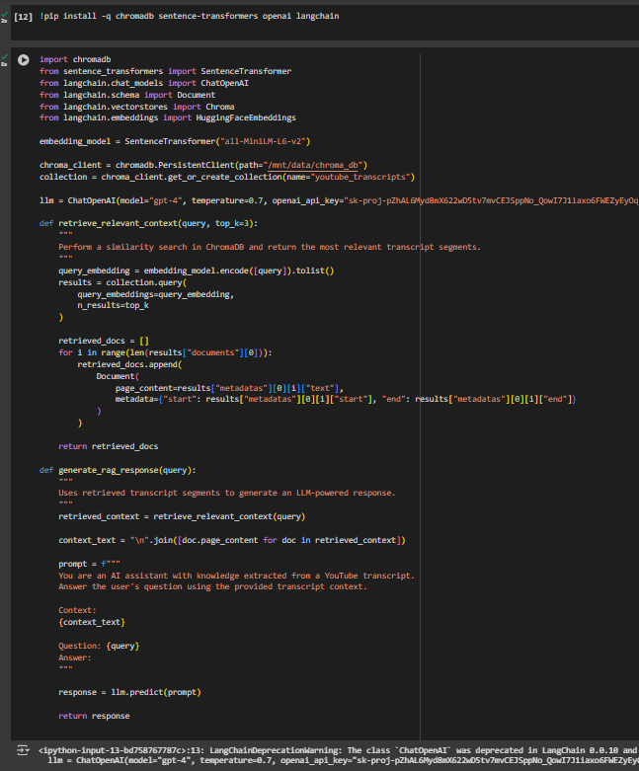
Implementing RAG for Transcript Search
Retrieval-Augmented Generation (RAG) Implementation
Extracts transcript data from YouTube
Converts transcript into embeddings using a vector store (ChromaDB)
Allows users to query YouTube transcripts using similarity search
Key Features: Efficient transcript retrieval Enhances chatbot responses with accurate data Provides contextually relevant information

Slide 8
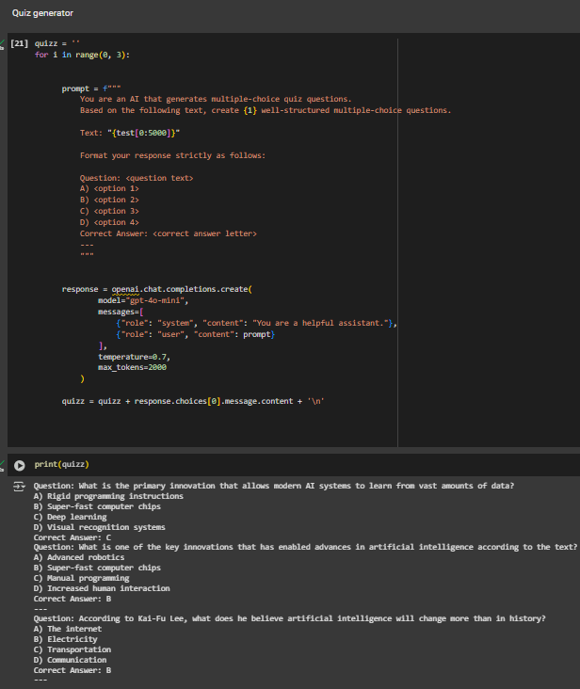
Quiz Generator
How It Works:
Uses an AI model to generate multiple-choice quiz questions from retrieved transcript text
Formats questions in a structured way (question, options, correct answer)
Ensures quiz generation aligns with the chatbot’s retrieved content
Example Output: Question: What is the key innovation that has enabled AI advancements? A) Fast processors B) Limited memory C) Outdated software D) Slow learning rates Correct Answer: A

Slide 9
Chatbot Agent & Memory Integration
LangChain Agent Implementation:
Uses STRUCTURED_CHAT_ZERO_SHOT_REACT_DESCRIPTION to handle responses
Includes memory (ConversationBufferMemory) to track conversation history
Dynamically determines whether to retrieve information or generate a quiz
Capabilities: AI chatbot with contextual memory Quiz generation based on conversation input Provides engaging AI-powered educational experiences

Slide 10
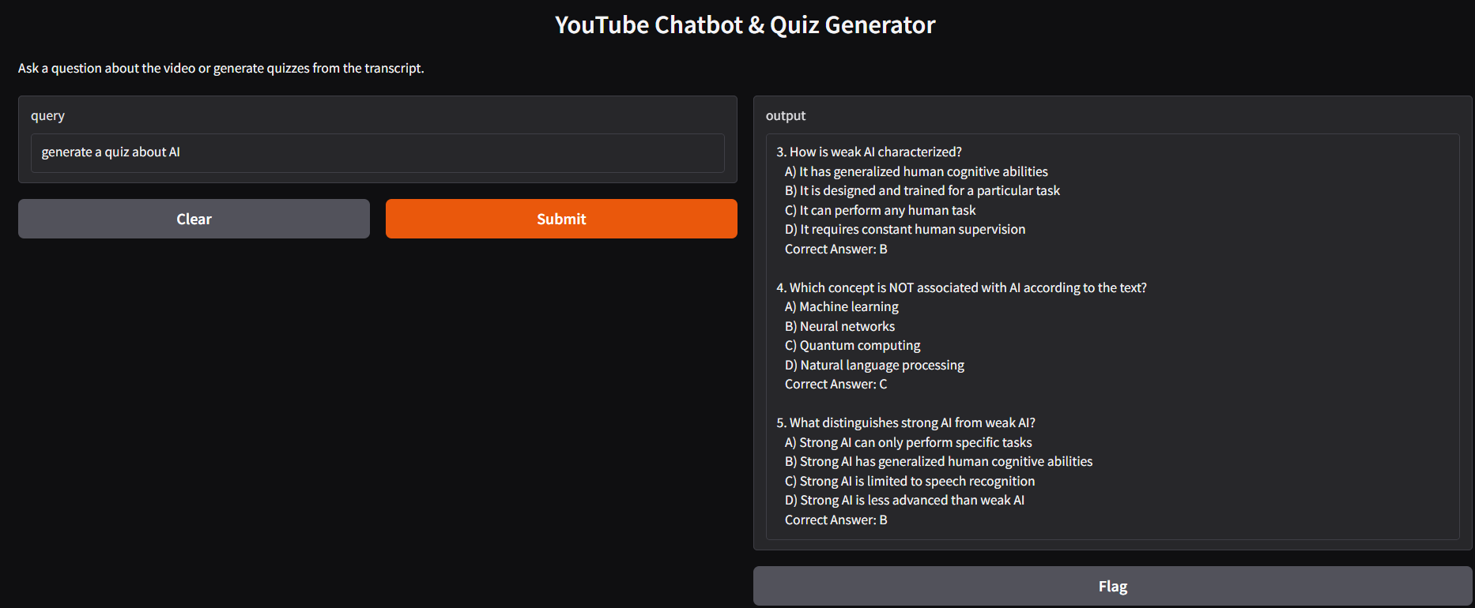
User Interface with Gradio
Text input for user queries
Submit button for interaction with the chatbot
Output section to display the responses and the generated quizzes

Slide 11
Challenges & Solutions
Challenges Faced:
Formatting issues when generating quiz responses
Input handling errors for JSON-based queries
Debugging agent execution flow
Solutions Implemented:
Refined JSON handling for quiz input
Improved error handling for structured agent interactions
Optimized chatbot response generation

Slide 12
Future Improvements
Integrate speech-to-text for verbal queries
Expand multi-modal support for video-based interactions
Improve the chatbot's ability to interpret complex queries.
Integrate more diverse YouTube transcripts.
Adapt quiz difficulty based on user performance.
Incorporate video and audio analysis for richer interactions.

Slide 13
Conclusion
EduAI is a step towards AI-driven education, combining semantic search, RAG-based retrieval, and interactive quizzes to improve learning experiences.It demonstrates how AI can be leveraged to extract knowledge from existing multimedia content efficiently.
Key Takeaways: Successfully implemented a chatbot that retrieves and processes YouTube transcript data AI-powered quiz generator provides an interactive learning experience
Integrated LangChain agents, memory, and OpenAI for intelligent responses
Next Steps: Deploy the system for real-world testing & refine user experience

Slide 14
THANK YOU
Marvin Mends

